Slide 1
Eagle Mountain-Saginaw Independent School District
Quarterly Report
3Q18

Slide 2
Economic Conditions – DFW Area (September 2018)
1.7%
35,066
63,352 new jobs
National rate 1.1%
Unemployment
Rate
2,980 more
starts than 3Q17
Job Growth
Annual
Home Starts
U.S. 3.6 %
Texas 3.7%
DFW MSA 3.4%
Fort Worth 3.5%
-0.1%
Sources: Texas Workforce Commission & Metrostudy

Slide 3
EMS ISD Housing Activity
November 2017 - October 2018 Home Sales by Type
EMS ISD had 3,491 home sales in the last 12 months, and roughly 21% were new homes.
Within EMS ISD, the average new home sale price in 3Q18 was $270,884.
Within EMS ISD, the average existing home sale price in 3Q18 was $238,630.

Slide 4
DFW New Home Ranking Report
ISD Ranked by Annual Closings – 3Q18
Rank | District Name | Annual Starts | Annual Closings | VDL | Future
1 | Prosper ISD | 2,900 | 2,698 | 5,071 | 22,777
2 | Frisco ISD | 2,367 | 2,310 | 4,926 | 5,139
3 | Denton ISD | 2,421 | 2,164 | 3,603 | 22,041
4 | Northwest ISD | 1,876 | 1,915 | 2,554 | 23,494
5 | Dallas ISD | 1,873 | 1,644 | 2,122 | 5,646
6 | Little Elm ISD | 1,352 | 1,456 | 1,429 | 2,611
7 | Eagle Mt.-Saginaw ISD | 1,318 | 1,303 | 1,568 | 20,845*
8 | Forney ISD | 1,335 | 1,247 | 1,589 | 15,749
9 | Lewisville ISD | 1,330 | 1,070 | 1,828 | 4,037
10 | Rockwall ISD | 894 | 897 | 2,244 | 9,602
11 | Wylie ISD | 868 | 885 | 999 | 3,769
12 | Crowley ISD | 1,005 | 804 | 1,407 | 13,186
13 | McKinney ISD | 790 | 785 | 1,923 | 8,571
14 | Princeton ISD | 792 | 694 | 716 | 7,937
15 | Mansfield ISD | 845 | 687 | 1,391 | 6,428
16 | Midlothian ISD | 669 | 672 | 1,072 | 19,743
17 | Allen ISD | 754 | 637 | 1,037 | 1,289
18 | Waxahachie ISD | 685 | 612 | 831 | 10,954
19 | Keller ISD | 530 | 603 | 651 | 1,563
20 | Royse City ISD | 702 | 582 | 1,263 | 9,355
* Based on additional Templeton Demographics housing research
Source: Metrostudy
Notes:
3Q18 Notes: 3Q17 EMS was number 12 on the list.

Slide 5
New Housing Activity
Eagle Mountain-Saginaw ISD
Starts | 2012 | 2013 | 2014 | 2015 | 2016 | 2017 | 2018 |  | Closings | 2012 | 2013 | 2014 | 2015 | 2016 | 2017 | 2018
1Q | 125 | 112 | 205 | 173 | 177 | 179 | 390 |  | 1Q | 138 | 144 | 181 | 154 | 189 | 154 | 295
2Q | 148 | 253 | 209 | 268 | 223 | 368 | 411 |  | 2Q | 141 | 199 | 227 | 220 | 227 | 204 | 310
3Q | 196 | 193 | 210 | 293 | 243 | 412 | 293 |  | 3Q | 164 | 171 | 214 | 269 | 265 | 243 | 374
4Q | 168 | 176 | 188 | 207 | 124 | 224 |  |  | 4Q | 150 | 195 | 200 | 224 | 175 | 324
Total | 637 | 734 | 812 | 941 | 767 | 1,183 | 1,094 |  | Total | 593 | 709 | 822 | 867 | 856 | 925 | 979
EMS ISD had more than 370 home closings in the third quarter, the most 3Q closings in more than 10 years.
The district started nearly 300 new homes in 3Q18 and is on pace to start over 1,300 homes by the end of 2018.

Slide 6
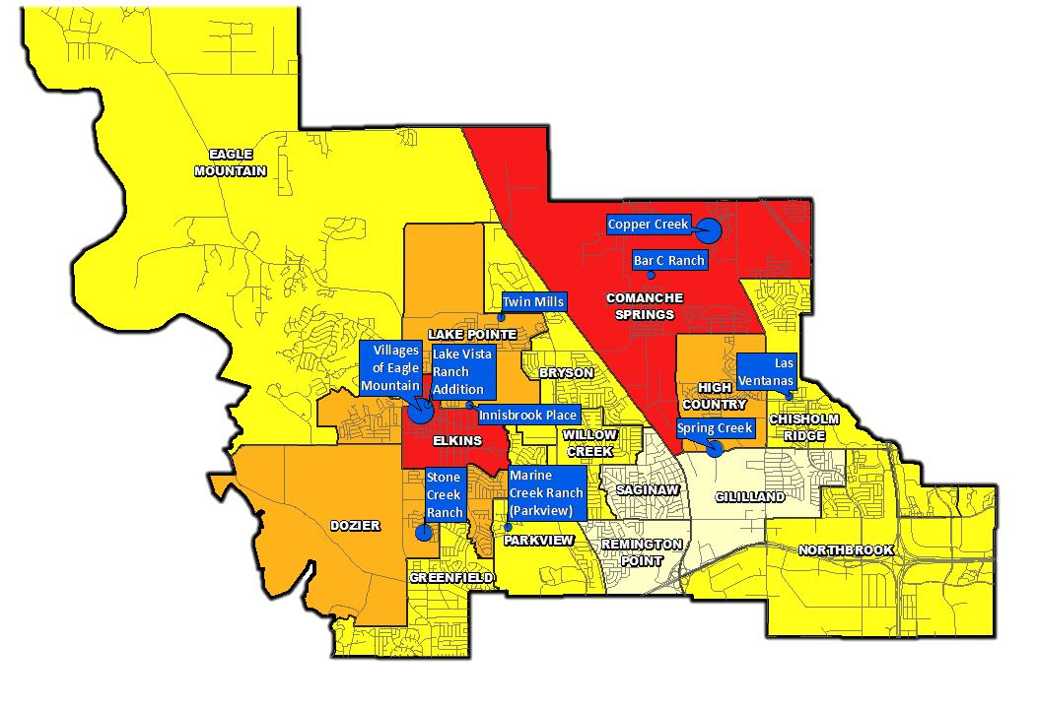
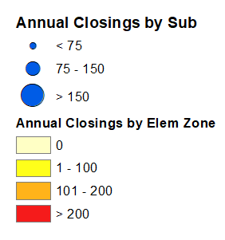
Annual Closings Distribution
Top 10 Subdivisions - 3Q18 (Ranked by Annual Closings)
Rank | Subdivision | Annual Closings | VDL | Future
1 | Villages of Eagle Mountain | 220 | 156 | 0
2 | Copper Creek | 180 | 70 | 677
3 | Spring Creek | 92 | 0 | 0
4 | Stone Creek Ranch | 80 | 126 | 173
5 | Lake Vista Ranch Addition | 70 | 116 | 174
6 | Marine Creek Ranch (Parkview) | 69 | 17 | 887
7 | Las Ventanas | 66 | 14 | 214
8 | Bar C Ranch | 56 | 66 | 614
9 | Twin Mills | 54 | 91 | 297
10 | Innisbrook Place | 51 | 35 | 116
 | TOTALS | 938 | 691 | 3,152

Slide 7
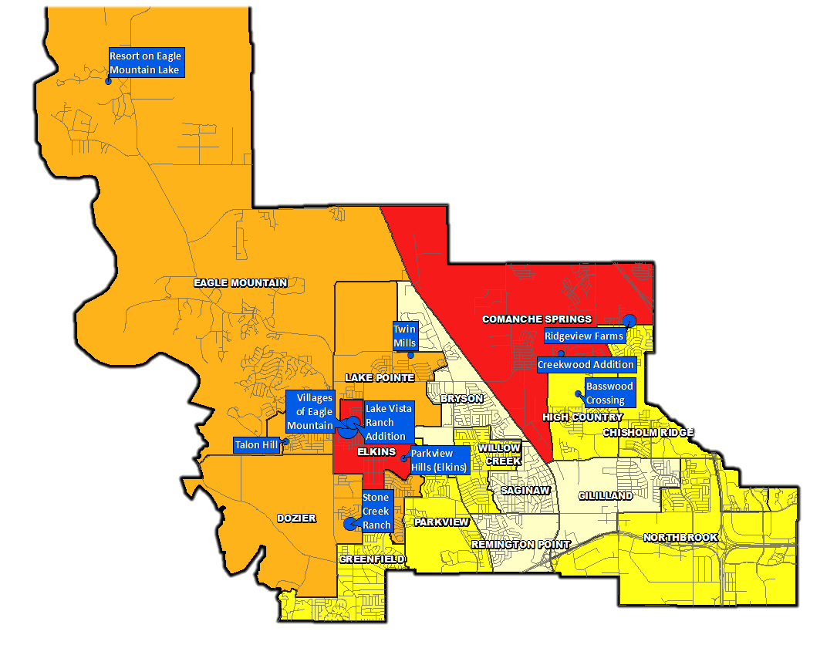
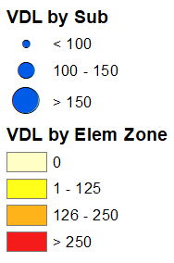
VDL Distribution
Top 10 Subdivisions - 3Q18 (Ranked by remaining VDL)
Rank | Subdivision | Annual Closings | VDL | Future
1 | Villages of Eagle Mountain | 220 | 156 | 0
2 | Ridgeview Farms | 7 | 128 | 222
3 | Stone Creek Ranch | 80 | 126 | 173
4 | Lake Vista Ranch Addition | 70 | 116 | 174
5 | Resort on Eagle Mountain Lake | 15 | 100 | 160
6 | Basswood Crossing | 50 | 99 | 213
7 | Twin Mills | 54 | 91 | 297
8 | Parkview Hills (Elkins) | 8 | 90 | 240
9 | Talon Hill | 18 | 75 | 233
10 | Creekwood Addition | 30 | 71 | 0
 | TOTALS | 552 | 1,052 | 1,712

Slide 8
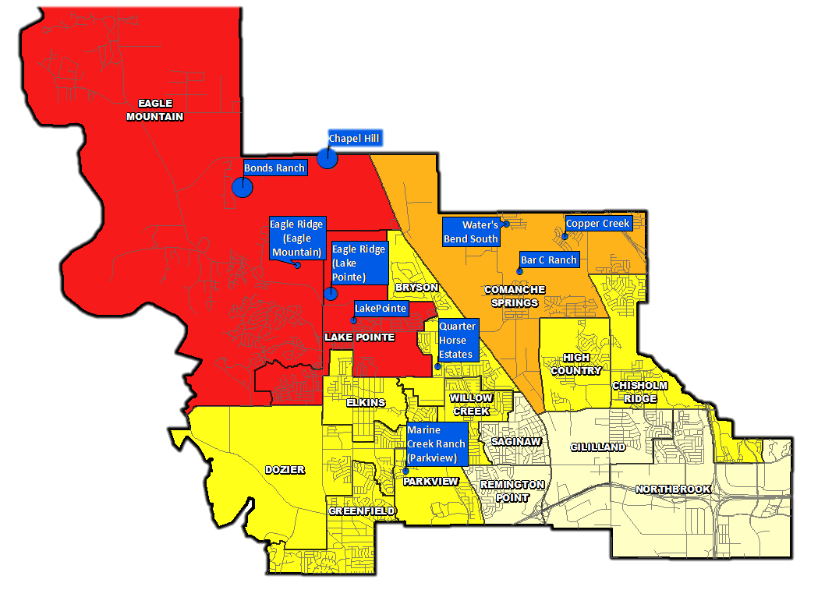
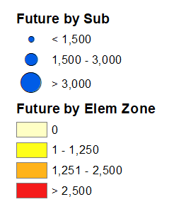
Futures Distribution
Top 10 Subdivisions - 3Q18 (Ranked by Future Inventory)
Rank | Subdivision | Annual Closings | VDL | Future
1 | Chapel Hill | 0 | 5 | 4,713
2 | Bonds Ranch | 0 | 0 | 4,065
3 | Eagle Ridge (Lake Pointe) | 0 | 0 | 2,500
4 | Marine Creek Ranch (Parkview) | 69 | 17 | 887
5 | Water's Bend South | 0 | 0 | 852
6 | Eagle Ridge (Eagle Mountain) | 0 | 0 | 800
7 | Copper Creek | 180 | 70 | 677
8 | Bar C Ranch | 56 | 66 | 614
9 | LakePointe | 0 | 3 | 594
10 | Quarter Horse Estates | 0 | 0 | 334
 | TOTALS | 305 | 161 | 16,036
Notes:
Note: Eagle Ridge is aka. North Pointe

Slide 9
District Housing Overview by Elementary Zone
Elementary Zone | Annual Starts | Quarter Starts | Annual Closings | Quarter Closings | Inventory | VDL | Future
BRYSON | 42 | 9 | 62 | 20 | 18 | 0 | 334
CHISHOLM RIDGE | 94 | 51 | 68 | 21 | 68 | 21 | 850
COMANCHE SPRINGS | 325 | 87 | 273 | 65 | 217 | 350 | 2,365
DOZIER | 154 | 17 | 118 | 54 | 58 | 179 | 798
EAGLE MOUNTAIN | 59 | 13 | 51 | 11 | 49 | 238 | 10,515
ELKINS | 236 | 21 | 309 | 75 | 77 | 373 | 414
GILILLAND | 0 | 0 | 0 | 0 | 0 | 0 | 0
GREENFIELD | 5 | 4 | 4 | 0 | 4 | 13 | 266
HIGH COUNTRY | 147 | 46 | 142 | 34 | 66 | 99 | 213
LAKE POINTE | 181 | 24 | 125 | 65 | 102 | 240 | 4,129
NORTHBROOK | 5 | 0 | 33 | 1 | 1 | 7 | 0
PARKVIEW | 35 | 14 | 77 | 18 | 18 | 17 | 887
REMINGTON POINT | 0 | 0 | 0 | 0 | 0 | 0 | 0
SAGINAW | 0 | 0 | 0 | 0 | 0 | 0 | 0
WILLOW CREEK | 35 | 7 | 41 | 10 | 10 | 31 | 74
GRAND TOTAL | 1,318 | 293 | 1,303 | 374 | 688 | 1,568 | 20,845
 | Highest activity in the category
 | Second highest activity in the category
 | Third highest activity in the category

Slide 10
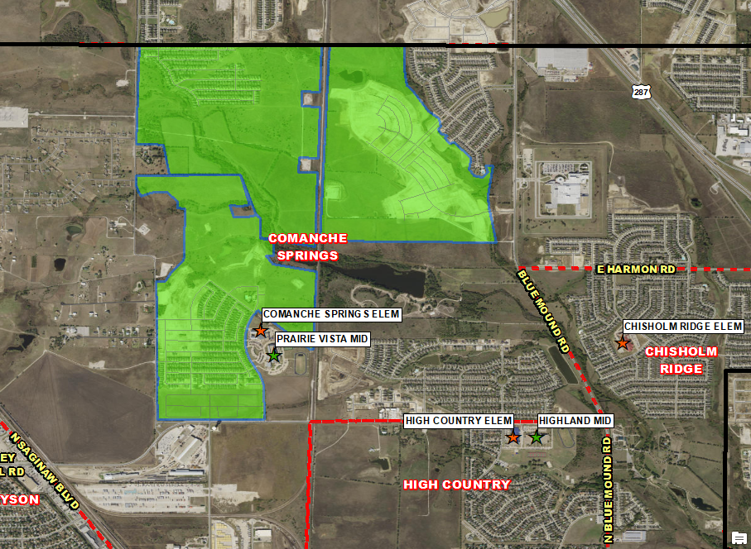
Residential Activity
Water’s Bend South
1,142 total lots
852 futures
285 occupied
5 under construction
Groundwork underway on Sec 1D (81 lots) delivering spring 2019
$250K-$400K
Current student yield = 0.64
Copper Creek
951 total lots
677 futures
181 occupied
14 under construction
70 VDL
Groundwork underway in Sec 3 (158 lots) and Sec 4A (176 lots)
Anticipate building 150-175 homes per year
$230K-$360K
Current student yield = 0.25
Bar C Ranch
1,315 total lots
614 futures
512 occupied
91 under construction
66 VDL
Building ~120-150 homes a year
$210K-$275K
Current student yield = 0.79

Slide 11
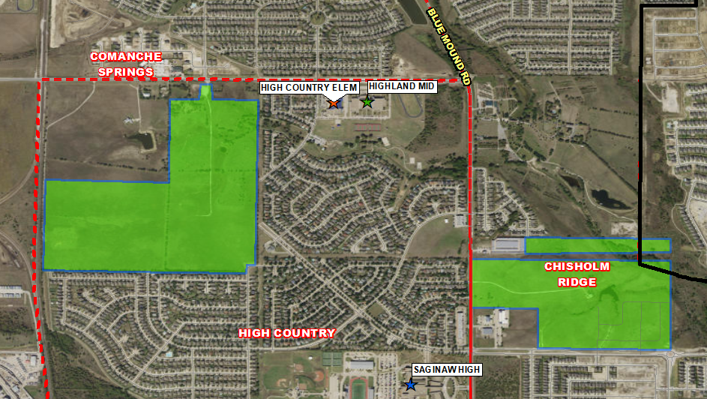
Residential Activity
Las Ventanas
322 total lots
214 futures
73 occupied
9 under construction
14 VDL
Groundwork underway on Phase 2 (121 lots) & 3 (93 lots), delivering spring 2019
$260K-$370K
Building ~60 homes a year
Current student yield = 0.16
Basswood Crossing
427 total lots
213 futures
50 occupied
56 under construction
99 VDL
Phase 2 (139 lots) delivered 2Q18; homebuilding underway
First closings and move-ins for Phase 2 expected in Dec 2018
$250K-$320K
Building 100- 125 homes a year
Current student yield = 0.18

Slide 12
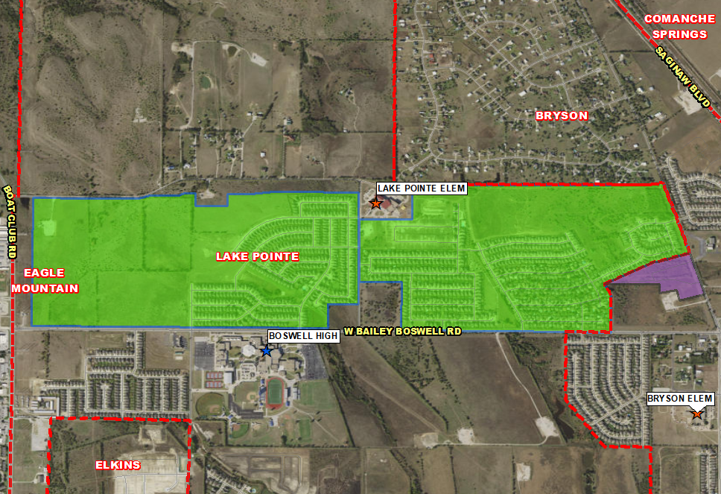
Residential Activity
Twin Mills
1137 total lots
297 futures
713 occupied
23 under construction
91 VDL
DR Horton delivered Sec 3 (152 lots) 3Q18; homebuilding underway
Building ~100 homes a year
$217K+
Current student yield = 0.66
LakePointe
1,069 total lots
594 futures
472 occupied
Restarting development with groundwork on Sec 4 (137 lots) underway, expected delivery early 2019
Building ~100 homes a year
$120K-$180K
Current student yield = 0.77

Slide 13
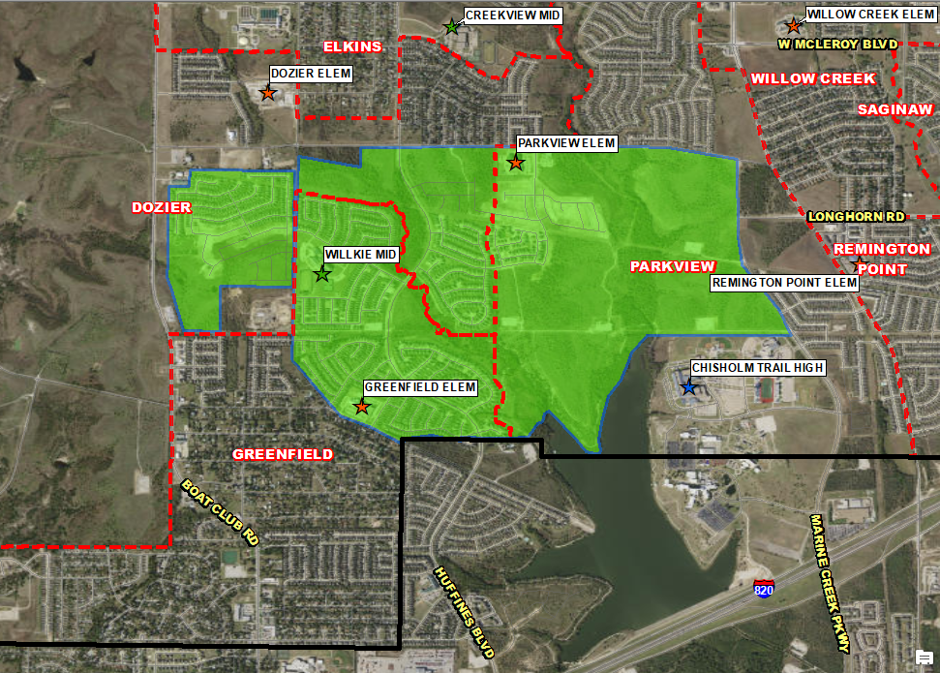
Residential Activity
Stone Creek Ranch
863 total lots
173 futures
542 occupied
126 VDL
Homebuilding in Sec 6B (125 lots) est to begin by end of 2018; lots delivered 3Q18
Building ~150 homes a year
$220K-$245K
Current student yield = 0.68
Marine Creek Ranch
2,656 total lots
1,031 futures
1,503 occupied
36 under construction
69 VDL
Groundwork underway in Sec 13 (105 lots) and Sec 4 (38 lots)
Building ~100-110 homes per year
$250K-$330K
Current student yield = 0.65

Slide 14
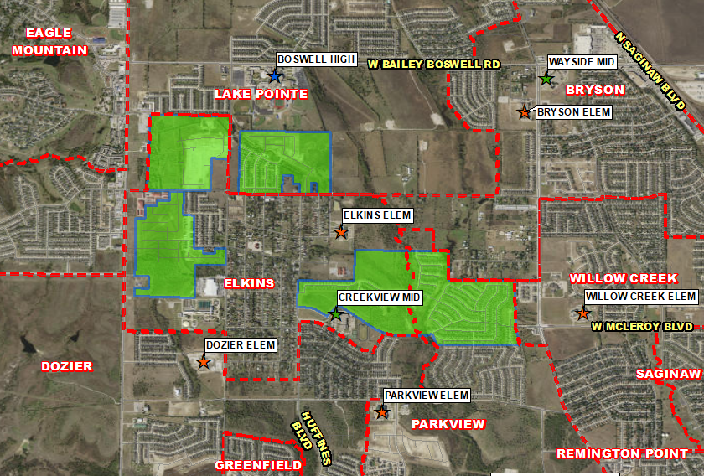
Residential Activity
Innisbrook Place
390 total lots
116 futures
199 occupied
33 under construction
35 VDL
Groundwork underway in Sec 3 (52 lots) with estimated delivery in early 2019
Building ~50 homes a year
$220K-$360K
Current student yield = 0.55
Lake Vista Ranch Addition
498 total lots
174 futures
173 occupied
25 under construction
116 VDL
Building ~70-80 homes a year
$215K-$300K
Current student yield = 0.80
Villages of Eagle Mountain
487 total lots
308 occupied
1 under construction
156 VDL
21 finished vacant lots remaining in Sec 3
Final 140 lots delivered 3Q18
Building ~220 homes per year
$210K-$260K
Current student yield = 0.60
Parkview Hills
1,064 total lots
240 futures
721 occupied
6 under construction
90 VDL
Sec 7 (11 lots) delivered 3Q18 to Lennar, homebuilding underway
Building ~30-40 homes per year
$220K-$300K
Current student yield = 0.89
Notes:
Notes: Parkview Hills- homebuilding occurring in Elkins Elem Zone

Slide 15
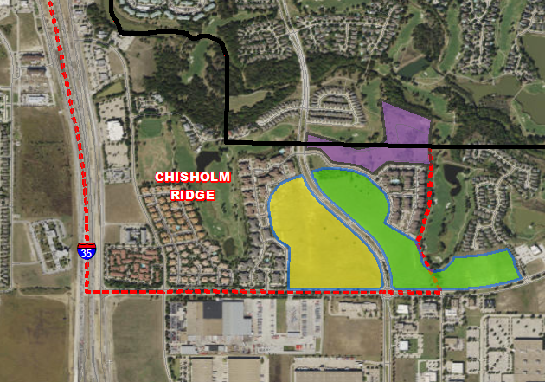
Residential Activity
Cortland Riverside Apartments
375 units
Currently pre-leasing units with first move ins underway
All units complete and leasing April 2019
Split with Keller ISD
Enclave at Fossil Creek
170 total future lots
Streets paving in Sec 1 (79 lots)
Groundwork underway on Sec 2 (91 lots); delivering early 2019
Meadows of Fossil Creek
150 total lots
97 futures
First section delivered 2Q18
45 homes started in 3Q18
Groundwork underway on remaining 97 lots
Building ~50-60 homes per year
$270K-$320K
No current student yield

Slide 16
Ten Year Forecast
By Elementary Campus
 |  | History | Current | ENROLLMENT PROJECTIONS
Campus | Capacity | 2017/18 | 2018/19 | 2019/20 | 2020/21 | 2021/22 | 2022/23 | 2023/24 | 2024/25 | 2025/26 | 2026/27 | 2027/28 | 2028/29
HAFLEY DEVELOPMENT CENTER | 512 | 473 | 452 | 452 | 452 | 452 | 452 | 452 | 452 | 452 | 452 | 452 | 452
BRYSON ELEMENTARY | 675 | 489 | 541 | 582 | 593 | 583 | 590 | 611 | 614 | 606 | 608 | 610 | 612
CHISHOLM RIDGE ELEMENTARY | 803 | 664 | 669 | 687 | 712 | 746 | 764 | 794 | 803 | 808 | 816 | 817 | 811
COMANCHE SPRINGS ELEM | 753 | 662 | 715 | 767 | 845 | 925 | 1,008 | 1,068 | 1,164 | 1,245 | 1,330 | 1,414 | 1,495
DOZIER ELEMENTARY | 803 | 639 | 697 | 740 | 809 | 855 | 930 | 956 | 993 | 1,020 | 1,034 | 1,051 | 1,062
EAGLE MOUNTAIN ELEMENTARY | 758 | 650 | 649 | 661 | 679 | 710 | 752 | 776 | 812 | 868 | 918 | 959 | 998
ELKINS ELEMENTARY | 605 | 318 | 360 | 397 | 446 | 474 | 518 | 550 | 596 | 608 | 609 | 614 | 601
GILILLAND ELMENTARY | 734 | 501 | 517 | 501 | 504 | 504 | 511 | 510 | 512 | 511 | 512 | 509 | 500
GREENFIELD ELEMENTARY | 803 | 709 | 742 | 744 | 738 | 760 | 765 | 767 | 764 | 764 | 774 | 779 | 787
HIGH COUNTRY ELEMENTARY | 745 | 532 | 545 | 547 | 550 | 595 | 610 | 636 | 665 | 676 | 679 | 689 | 691
LAKE POINTE ELEMENTARY | 779 | 699 | 712 | 756 | 790 | 874 | 937 | 982 | 1,062 | 1,137 | 1,216 | 1,299 | 1,394
NORTHBROOK ELEMENTARY | 779 | 597 | 555 | 620 | 666 | 682 | 691 | 695 | 685 | 686 | 671 | 671 | 671
PARKVIEW ELEMENTARY | 779 | 493 | 510 | 521 | 547 | 589 | 630 | 681 | 716 | 745 | 775 | 796 | 817
REMINGTON POINT ELEM | 758 | 490 | 479 | 474 | 473 | 491 | 493 | 518 | 529 | 526 | 525 | 529 | 535
SAGINAW ELEMENTARY | 519 | 375 | 352 | 348 | 339 | 359 | 367 | 373 | 380 | 387 | 388 | 387 | 388
WILLOW CREEK ELEMENTARY | 727 | 598 | 606 | 583 | 564 | 558 | 559 | 577 | 583 | 581 | 581 | 583 | 582
ELEMENTARY TOTALS | 11,532 | 8,889 | 9,101 | 9,380 | 9,707 | 10,157 | 10,577 | 10,946 | 11,330 | 11,620 | 11,888 | 12,159 | 12,396
Elementary Percent Change |  | -3.715% | 2.38% | 3.07% | 3.49% | 4.64% | 4.14% | 3.49% | 3.51% | 2.56% | 2.31% | 2.28% | 1.95%
Elementary Absolute Change |  | -343 | 212 | 279 | 327 | 450 | 420 | 369 | 384 | 290 | 268 | 271 | 237
*Green box = within 5% of capacity
*Yellow box = over capacity

Slide 17
Ten Year Forecast
By Middle School & High School Campus
 |  | History | Current | ENROLLMENT PROJECTIONS
Campus | Capacity | 2017/18 | 2018/19 | 2019/20 | 2020/21 | 2021/22 | 2022/23 | 2023/24 | 2024/25 | 2025/26 | 2026/27 | 2027/28 | 2028/29
CREEKVIEW MIDDLE SCHOOL | 1,078 | 902 | 998 | 1,008 | 1,007 | 979 | 965 | 1,022 | 1,065 | 1,163 | 1,219 | 1,278 | 1,332
HIGHLAND MIDDLE SCHOOL | 1,050 | 856 | 881 | 934 | 936 | 903 | 883 | 885 | 911 | 902 | 938 | 957 | 980
PRAIRIE VISTA MIDDLE SCHOOL | 1,002 | 820 | 881 | 944 | 992 | 1,007 | 1,027 | 1,075 | 1,130 | 1,189 | 1,242 | 1,307 | 1,359
WAYSIDE MIDDLE SCHOOL | 1,002 | 880 | 956 | 1,006 | 1,060 | 1,075 | 1,057 | 1,080 | 1,115 | 1,184 | 1,230 | 1,283 | 1,335
WILLKIE MIDDLE SCHOOL | 1,002 | 959 | 1,042 | 1,134 | 1,178 | 1,160 | 1,136 | 1,096 | 1,159 | 1,226 | 1,294 | 1,303 | 1,305
NEW MIDDLE SCHOOL |  | 0 | 0 | 0 | 0 | 0 | 0 | 0 | 0 | 0 | 0 | 0 | 0
MIDDLE SCHOOL TOTALS | 5,134 | 4,417 | 4,758 | 5,026 | 5,173 | 5,124 | 5,068 | 5,158 | 5,380 | 5,664 | 5,923 | 6,128 | 6,311
Middle School Percent Change |  | -2.56% | 7.72% | 5.63% | 2.92% | -0.95% | -1.09% | 1.78% | 4.30% | 5.28% | 4.57% | 3.46% | 2.99%
Middle School Absolute Change |  | 116 | 341 | 268 | 147 | -49 | -56 | 90 | 222 | 284 | 259 | 205 | 183
BOSWELL HIGH SCHOOL |  | 1,898 | 2,046 | 2,147 | 2,146 | 2,227 | 2,302 | 2,339 | 2,411 | 2,384 | 2,428 | 2,510 | 2,614
SAGINAW HIGH SCHOOL |  | 1,898 | 1,897 | 1,910 | 1,954 | 2,025 | 2,152 | 2,234 | 2,246 | 2,319 | 2,336 | 2,371 | 2,475
CHISHOLM TRAIL HIGH SCHOOL |  | 2,078 | 2,025 | 2,094 | 2,181 | 2,281 | 2,409 | 2,528 | 2,550 | 2,560 | 2,596 | 2,645 | 2,774
WATSON HIGH SCHOOL |  | 90 | 94 | 94 | 94 | 94 | 94 | 94 | 94 | 94 | 94 | 94 | 94
HIGH SCHOOL TOTALS |  | 5,964 | 6,062 | 6,245 | 6,375 | 6,627 | 6,957 | 7,195 | 7,301 | 7,357 | 7,454 | 7,620 | 7,957
High School Percent Change |  | 2.35% | 1.64% | 3.02% | 2.08% | 3.95% | 4.98% | 3.42% | 1.47% | 0.77% | 1.32% | 2.23% | 4.42%
High School Absolute Change |  | 137 | 98 | 183 | 130 | 252 | 330 | 238 | 106 | 56 | 97 | 166 | 337
TARRANT COUNTY JJAEP |  | 2 | 0 | 0 | 0 | 0 | 0 | 0 | 0 | 0 | 0 | 0 | 0
ALTERNATIVE DISCIPLINE SCHOOL |  | 45 | 36 | 36 | 36 | 36 | 36 | 36 | 36 | 36 | 36 | 36 | 36
ALTERNATIVE SCHOOL TOTALS |  | 47 | 36 | 36 | 36 | 36 | 36 | 36 | 36 | 36 | 36 | 36 | 36
DISTRICT TOTALS |  | 19,317 | 19,957 | 20,687 | 21,291 | 21,944 | 22,638 | 23,335 | 24,047 | 24,677 | 25,301 | 25,943 | 26,700
District Percent Change |  | -1.71% | 3.31% | 3.66% | 2.92% | 3.07% | 3.16% | 3.08% | 3.05% | 2.62% | 2.53% | 2.54% | 2.92%
District Absolute Change |  | -336 | 640 | 730 | 604 | 653 | 694 | 697 | 712 | 630 | 624 | 642 | 757
*Green box = within 5% of capacity
*Yellow box = over capacity

Slide 18
Summary
Fort Worth’s unemployment rate is at 3.5%.
The wet fall impacted new home starts during 3rd quarter.
Even with the wet fall the district is still on pace to start over 1,300 new homes.
EMS ISD can expect an increase of approximately 3,370 students during the next 5 years.
EMS ISD is projected to enroll 26,700 students for the 2028/29 school year.
www.tdemographics.com

